Slide 1

Introduction to Marketing

Slide 2
Agenda
Part 1: What is Marketing?
Part 2: Core marketing concepts
Part 3: Marketing Management

Slide 3
Common Misconceptions about Marketing
Many view marketing as just selling and advertising.
Selling and advertising are only parts of marketing.
Marketing includes a variety of roles and strategies.
Focus is on holistic customer engagement.

Slide 4
What is Marketing ?
Marketing is about meeting customer needs, not just making a sale.
Shifts focus from 'selling' to 'satisfying'.
Emphasis on customer satisfaction as a core goal.
Builds long-term relationships with customers.

Slide 5

What is Marketing ?
Marketing encompasses more than just transactions.
It involves research, product development, and customer support.
Prioritizes understanding and fulfilling customer needs.
Drives brand loyalty and customer retention.

Slide 6

Case Study: Northeastern Hospital
Northeastern Hospital is a private healthcare facility that focuses on patient-centered care. Recently, the hospital introduced a mobile app allowing patients to schedule appointments, access test results, and communicate with their healthcare providers. This move came after patient feedback indicated a desire for easier access to health information and services. The hospital also implemented a “Patient Navigator Program,” which assigns a dedicated staff member to guide patients through their healthcare journey, from admission to post-discharge care. Northeastern Hospital believes that by focusing on patient needs and satisfaction, they will encourage more people to choose them for long-term healthcare.

Slide 7
case study
1- In what ways does the Hospital demonstrate the shift from “selling” to “satisfying” in its approach to patient care?
2- Why might some people mistakenly think that Hospital’s mobile app and Patient Navigator Program are not “marketing”?
3- What other marketing functions, beyond selling, are being utilized by Northeastern Hospital?

Slide 8
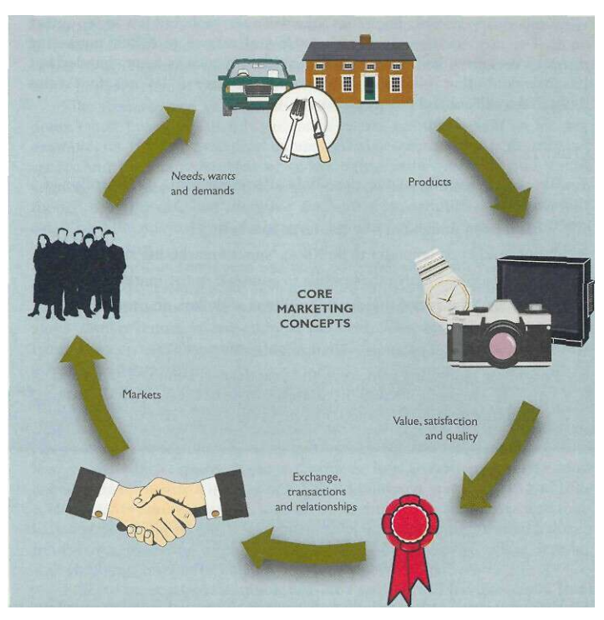

Core Marketing Concepts

Slide 9
Needs. Wants and Demands
Human need : A state of felt deprivation.
These include basic physical needs for food, clothing, warmth and safety; social needs for belonging and affection; and individual needs for knowledge and self-expression
Human want: The form that a human need takes as shaped by culture and individual personality.
Demands: Human wants that are backed by buying power
When backed by an ability to pay - that is, buying power - wants become demands.

Slide 10
Products and Services
Product Anything that van be offered to a market for attention, use or consumption that might satisfy a want or need. It includes physical objects, services, persons, places, organizations and ideas. s
Service Any activity or benefit that one party can offer to another which is essentially intangible and does not result in ownership of anything

Slide 11
Value, Satisfaction and Quality
Customer value: The consumer's assessment of the product's overall capacity to satisfy his or her needs
Customer satisfaction: The extent to -which a product's perceived performance matches a buyers expectations. If the product's performance falls shore, of expectations, the buyer is disatisfied. If performance matches or exceeds expectations the buyer is satisfied, or delighted.
Total quality management (TQM): Programmes designed to constantly improve the quality of products, service and marketing processes

Slide 12
Exchange, Transactions and Relationships
Exchange: The act of obtaining a desired object from someone by offering something in return.
Transaction: A erode between i parties that involves at least two things of value, agreed-upon conditions, a time of agreement and a place of agreement.
Relationship marketing: The process recreating, maintaining and enhancing strong, valueladen relationships with customers and other stakeholders.

Slide 13
Markets
The concept of exchange leads to the concept of a market.
Market: The set of all actual arid potential buyers of a product or service.
These buyers share a particular need or want that can be satisfied through exchange.
Thus, The size of a market is determined by the number of people who have the need, the resources to engage in exchange, and the willingness to offer those resources in exchange for what they desire.
Marketing means managing markets to bring about exchanges for the purpose of satisfying human needs and wants.

Slide 14
Marketing Management
Marketing management: The analysis, planning, implementation arid control of programmes designed to create, build and maintain beneficial exchanges with target buyer a for the purpose of achieving organisational objectives.
Thus, marketing management involves managing demand, which in turn involves managing customer relationships.

Slide 15

Demand Management
Marketing management ensures the organization maintains the desired level of demand for its products.
Demand may fluctuate between no demand, adequate demand, irregular demand, or excessive demand at any given time.
Marketing management must address and adapt to these varying demand states.
It is responsible for not only increasing demand but also for managing, changing, or reducing it when necessary.
Demarketing: Marketing to reduce demand temporarily or permanently - the aim is not to destroy demand but only to reduce or shift it

Slide 16

Building Profitable Customer Relationships
Managing demand means managing customers.
A company's demand comes from two groups: new customers and repeat customers.
Beyond designing strategics to attract new customers and create transactions with them, companies are now going all out to retain current customers and build lasting customer relationships
Companies are also realizing that losing a customer means more than losing a single sale - it means losing the entire stream of purchases that the customer would make over a lifetime of patronage.

Slide 17

Task
How your company applies at least three of the following core marketing concepts in real life:
Needs, Wants, and Demands
Value, Satisfaction, and Quality
Exchange and Transactions
Relationship Marketing
Demand Management
Customer Retention Strategies

Slide 18
Thank You
Any questions or Feedback

